Slide 1

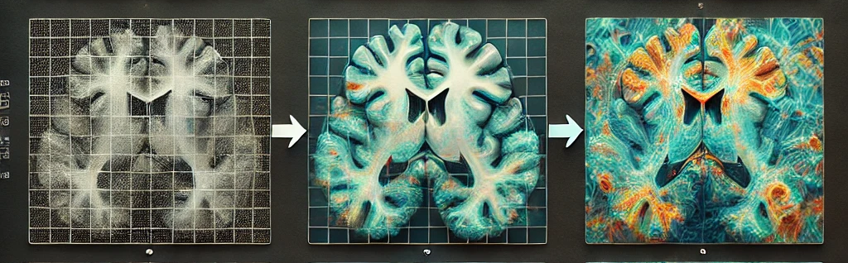
Diffusion Model For Medical Images
Capstone Project Phase B
24-2-R-5
Roi Darom
Hagar Tibi
Supervisors: Dr. Renata Avros & Prof. Zeev Volkovich
Notes:
הרחבת המודל הקיים לאוביקטים מוסווים עבור תמונות MRI , במקור היו תמונות של חיות בעיקר צריך עוד
Hello everyone, I'm Hagar, and this is Roi. Today, we'll be discussing the DiffCOD model for MRI images.

Slide 2
Purpose of the project
Enhancing the existing model for Camouflaged object detection to support MRI images
Explore Differences between animal images and MRI images, such as texture, structure, and context, may impact detection accuracy
Notes:
הרחבת המודל הקיים לאוביקטים מוסווים עבור תמונות MRI , במקור היו תמונות של חיות בעיקר צריך עוד
One of the main objectives of our work is to enhance the existing model for camouflaged object detection, adapting it to effectively support MRI images. The DiffCOD model has shown promising results in detecting hidden patterns in complex visual data, but adapting it for MRI images introduces unique challenges that we aim to address When transitioning from animal images to MRI images, several key differences must be considered. Unlike animal images, where texture and color often dominate, MRI images are grayscale, emphasizing structure and subtle gradients. Additionally, the context of the data is entirely different—MRI images capture medical information, focusing on internal anatomy rather than external features. These differences can significantly impact the model's detection accuracy, requiring modifications to the architecture or preprocessing techniques to optimize performance for MRI data

Slide 3
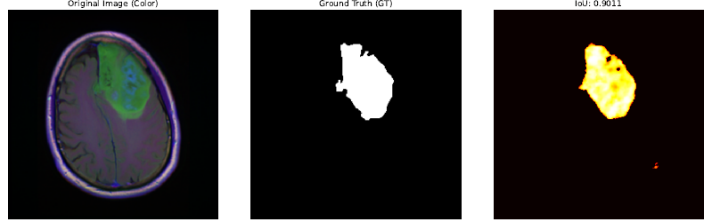
Solution
Incorporating multiple types of noise to enhance the accuracy of tumor detection.
Exploring multiple noise parameters to determine the optimal ones
Notes:
הזנה של מספר סוגי רעשים כדי לזהות את הגידול בצורה הטובה ביותר
צריך עוד דברים

Slide 4
What is Camouflage ?
Camouflage is the phenomenon where an object naturally blends into its environment, making it less noticeable to observers.
Camouflaged object detection is challenging due to the high visual similarity between the object and the background.
The problem is crucial in various fields like military, medical imaging, and wildlife monitoring.

Slide 5
Introduction to diffCOD Framework
Diffusion Models: Approach COD (Camouflaged Object Detection) as a denoising process
Training Process: The model learns to recognize objects within noised images using the reverse diffusion process
Key Component: Injection Attention Module (IAM) enhances the denoising capability

Slide 6
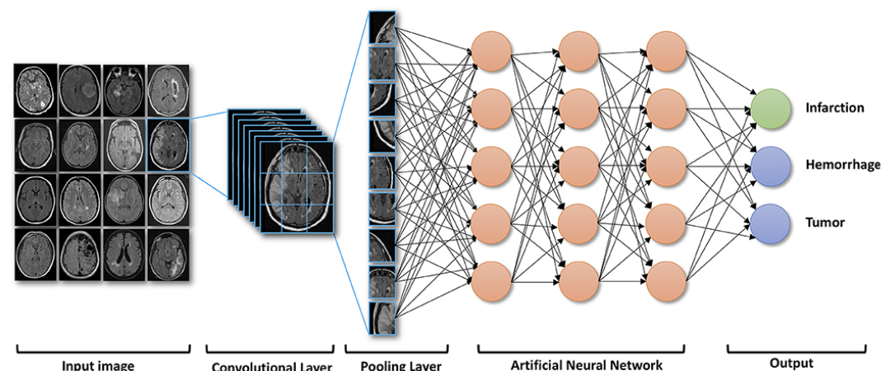
Medical Images Overview
MRI Characteristics:
3D structure, grayscale, and varied modalities (T1, T2, FLAIR).
Class Imbalance: Sparse pathological findings compared to healthy tissue.
Using MRI datasets cause the model focuses on:
Segmentation: Identifying key regions like abnormalities or tissues.
Preprocessing: Normalizing, reducing artifacts, and standardizing resolution.
Robustness: Handling noise, artifacts, and scanner variability.
3D Context: Leveraging spatial relationships for better analysis.
Notes:
רקע על תמונות MRI – מה מאפיין את התמונות בהקשר של אימון ובאיזה דברים המודל צריך להתמקד כשזה נוגע לתמונות MRI

Slide 7
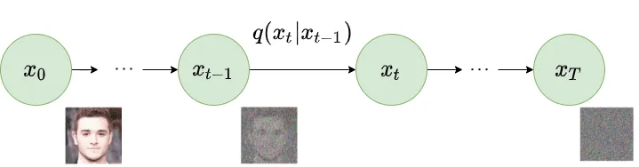
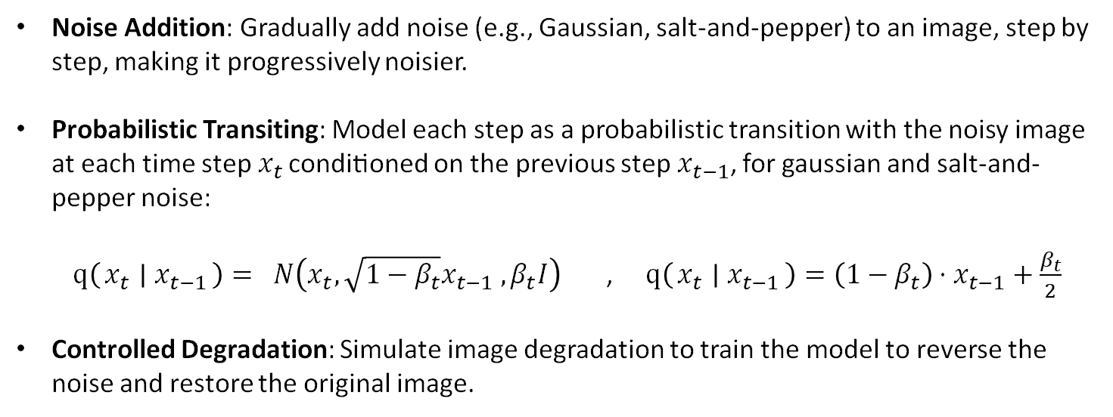
Forward DIFFUSION process
Noise Addition: Gradually add noise (e.g., Gaussian, salt-and-pepper) to an image, step by step, making it progressively noisier.
Probabilistic Transiting: Model each step as a probabilistic transition with the noisy image at each time step$x_{t}$​ conditioned on the previous step$x_{t−1}$​, for gaussian and salt-and-pepper noise: $q\left(x_{t} ∣ x_{t−1}\right)= N\left(x_{t}, \sqrt{1−β_{t}}x_{t−1} ,β_{t}I\right)$ , $q\left(x_{t} ∣ x_{t−1}\right)=\left(1−β_{t}\right)⋅x_{t−1}+\frac{β_{t}}{2}$
Controlled Degradation: Simulate image degradation to train the model to reverse the noise and restore the original image.

Slide 8
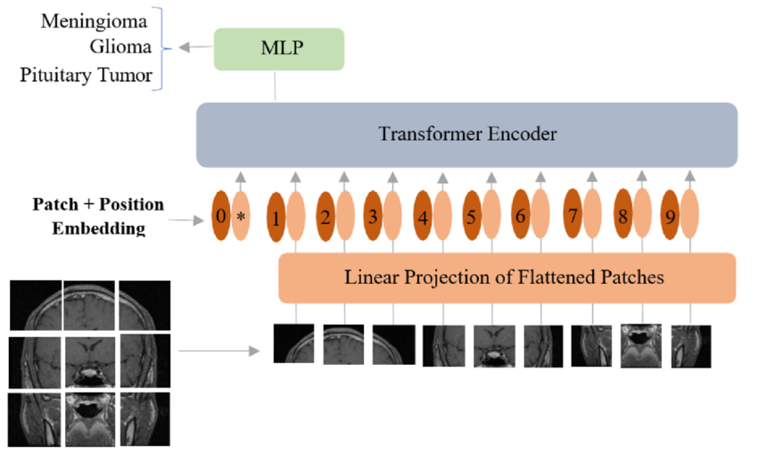
Vision Transformer (ViT)
The ViT is Used for image classification, detection, and segmentation, capturing local and global details. It’s also a backbone for multi-scale feature extraction in tasks like camouflaged object detection and image restoration.
ViT Process:
Patch Processing: Divides the image into patches, embeds each into a fixed-size vector.
Positional Encoding: Adds spatial information to patch embeddings.
Self-Attention Mechanism: Uses transformer layers to capture long-range dependencies.
Multi-Scale Feature Extraction: Processes patches at various resolutions to capture detailed features.

Slide 9
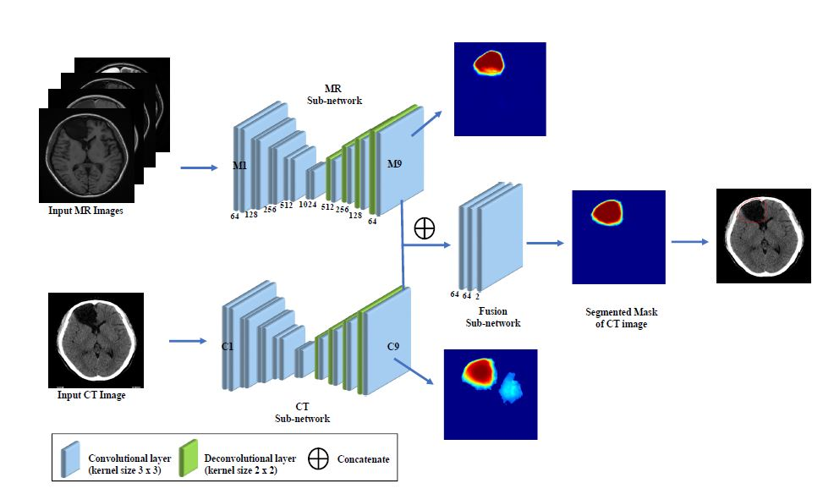
Feature Fusion (FF)
Multi-Scale Integration: The FF module merges features from different scales, capturing fine details and broader patterns, enriching the image representation.
Dynamic Weight Adjustment: During training, the module learns to prioritize key features with dynamic weights, often using attention mechanisms to improve focus.
Enhanced Image Processing: By combining multi-scale features, the FF module refines and improves image outputs, especially in tasks like restoration, segmentation and detection.

Slide 10
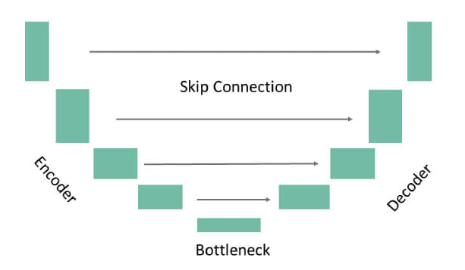
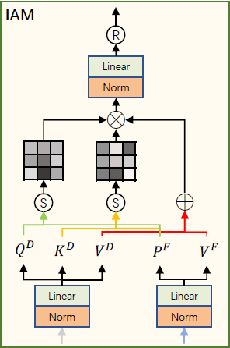
Denoising U-Net & IAM
Encoder: Downsamples the input, extracting multi-scale features while preserving essential information, reducing spatial dimensions progressively.
IAM in the Bottleneck: Integrated into U-Net's bottleneck, enhancing feature refinement by focusing on critical textures, guiding effective denoising.
Decoder: Upsamples encoded features to reconstruct the image, using transposed convolutions to restore resolution with a focus on detail.
Skip Connections: Link encoder and decoder layers, retaining high-resolution features to preserve fine details in the denoised output.

Slide 11
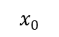
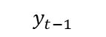

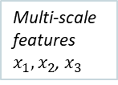
Model’s Process
Input Image
ViT – image processing
Multi-scale features$x_{1},x_{2}$, $x_{3}$
FF – feature extraction
$$x_{0}$$
$$x_{0}$$
Feature Map F
Noise addition
Denoising U-Net Encoder – Extract deepest features
IAM – guide diffusion process
Denoising U-Net Decoder – Produce Refined version
Detected Object/Anomaly
$$y_{t}$$
Feature Map D
Feature Map O
Gaussian/Salt &pepper Noise
$$y_{t−1}$$

Slide 12
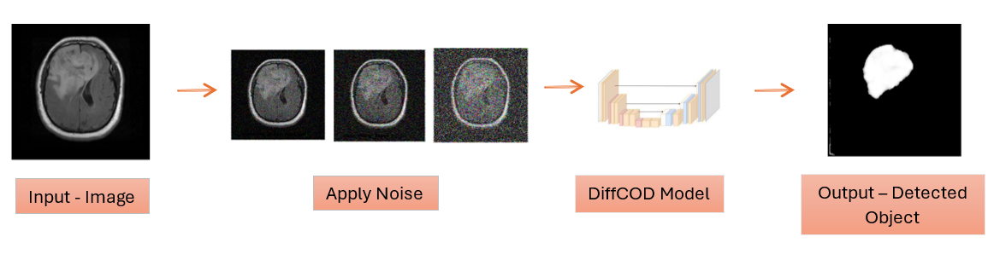
DIFFCOD – Train process
Input: Image from Brain MRI Dataset.
Adding Synthetic Noise: Simulating real-world conditions.
U-net Model Training: Iteratively mapping noisy to clean images.
Output: Ground Truth of detected anomaly.

Slide 13
U-net Architecture

Slide 14
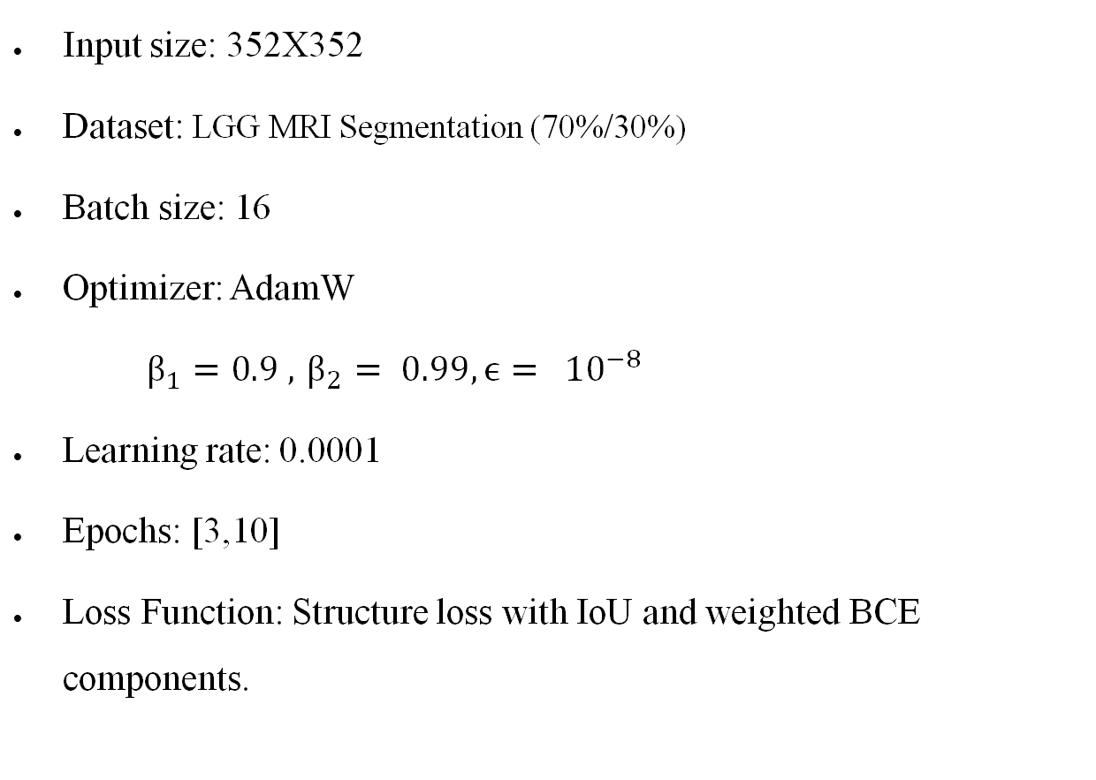
Hyperparameters
Input size: 352X352
Dataset: LGG MRI Segmentation (70%/30%)
Batch size: 16
Optimizer: AdamW
$β_{1}=0.9 , { β}_{2} = 0.99, ϵ= {10}^{−8}$
Learning rate: 0.0001
Epochs: [3,10]
Loss Function: Structure loss with IoU and weighted BCE components.
Notes:
In this model setup, the input size is 352x352, chosen to ensure a balance between computational efficiency and capturing sufficient detail for accurate tumor detection. The LGG MRI Segmentation dataset is used with a 70% training and 30% validation split, ensuring reliable model evaluation. A batch size of 16 is selected to optimize memory usage while maintaining stable gradient updates. The AdamW optimizer is employed for efficient weight updates, with β1=0.9, β2=0.99, and ϵ=${10}^{−8}$ for stability and better generalization. The learning rate is set to 0.0001 for steady and effective convergence. The model was trained and evaluated over multiple epochs, testing values from 3 to 10, to determine the optimal training duration for performance. The loss function combines structure loss with IoU and weighted Binary Cross-Entropy (BCE) components, ensuring the model accurately identifies tumor regions while handling complex spatial structures.

Slide 15
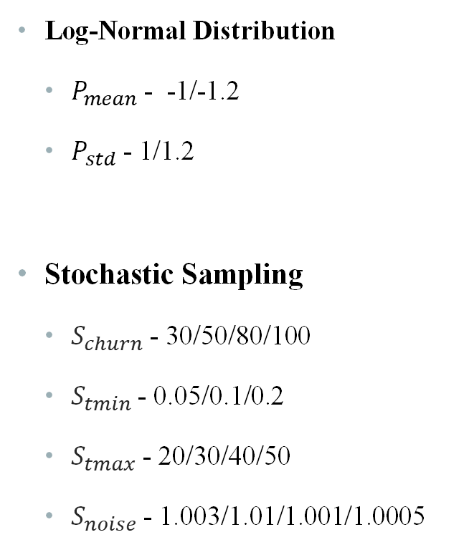
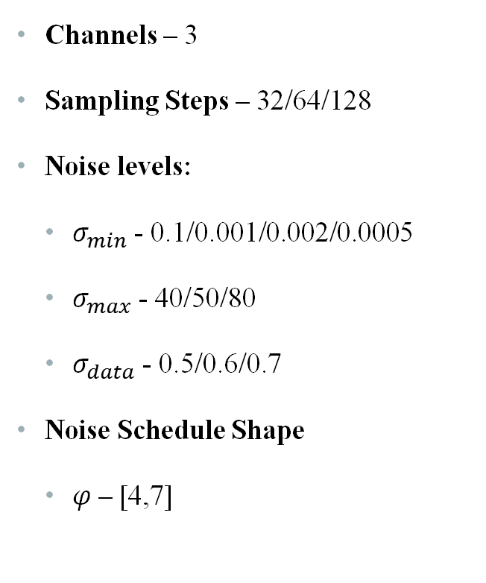
Noise parameters
Channels – 3
Sampling Steps – 32/64/128
Noise levels:
$σ_{min}$ - 0.1/0.001/0.002/0.0005
$σ_{max}$ - 40/50/80
$σ_{data}$ - 0.5/0.6/0.7
Noise Schedule Shape
$φ$– [4,7]
Log-Normal Distribution
$P_{mean}$ - -1/-1.2
$P_{std}$ - 1/1.2
Stochastic Sampling
$S_{churn}$ - 30/50/80/100
$S_{tmin}$- 0.05/0.1/0.2
$S_{tmax}$ - 20/30/40/50
$S_{noise}$ - 1.003/1.01/1.001/1.0005

Slide 16
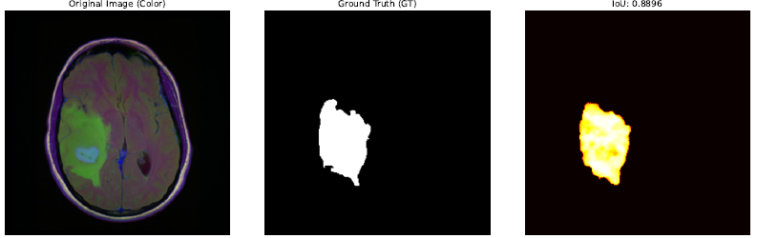
Result Examples – GAUSSIAN noise

Slide 17
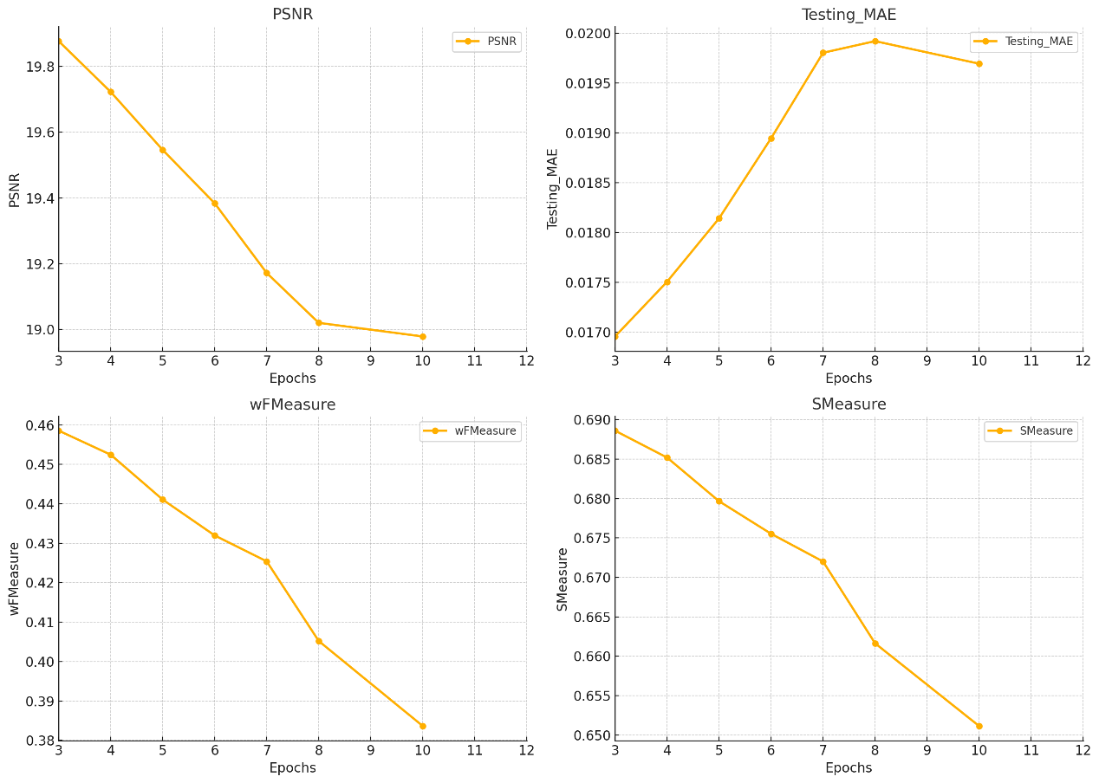
Metrics – GAUSSIAN noise

Slide 18
Metrics – GAUSSIAN noise

Slide 19
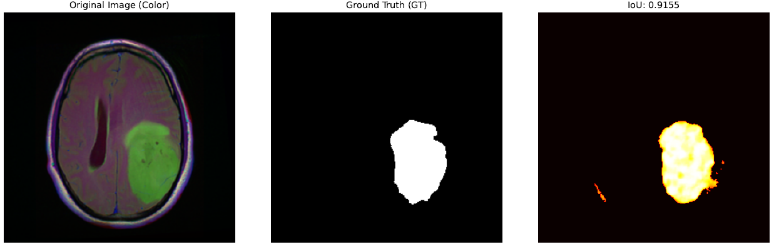
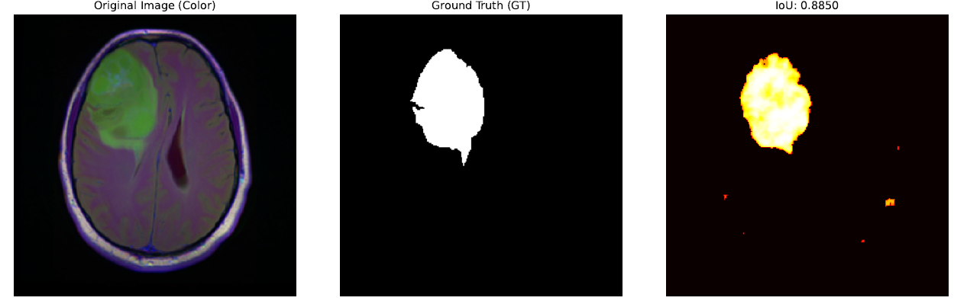
Result Examples – Salt & pepper noise

Slide 20
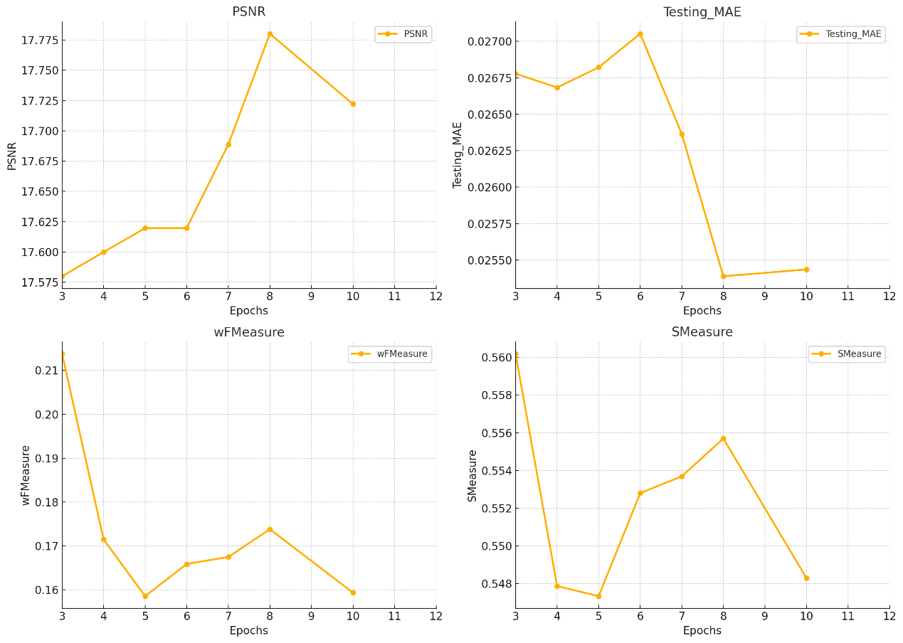
Metrics – Salt & pepper noise

Slide 21
Metrics – Salt & pepper noise

Slide 22

EXPECTED ACHIEVEMENTS
Explore DiffCOD model for medical imaging
Ground Truth output of detected anomaly
Achieve promising results
Notes:
להסביר מה היה בחלק א ומה בחלק ב'

Slide 23
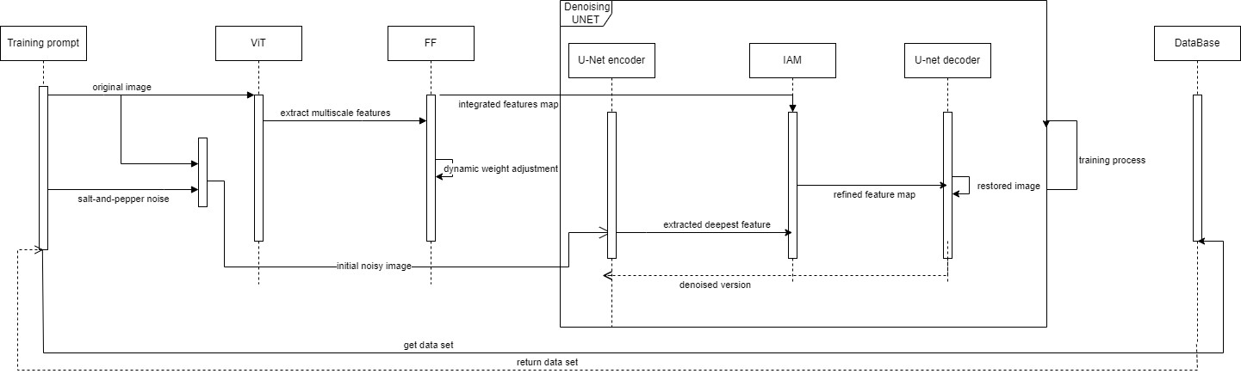
Sequence

Slide 24
Testing Results
GAUSSIAN NOISE
Original Model Paramters
Psnr | Testing MAE | wFMeasure | Smeasure | Training MAE | Training loss | Testing Size | Training Size | Epochs | batch | lr
17.5392 | 0.026853295 | 0.469996871 | 0.6804 | 0.02692 | 1.31993 | 404 | 961 | 3 | 16 | 1.00E-06
19.4712 | 0.0183977 | 0.401050027 | 0.659 | 0.03438 | 1.33922 | 404 | 961 | 4 | 16 | 1.00E-06
18.1817 | 0.020004711 | 0.442541521 | 0.6774 | 0.15962 | 1.29547 | 404 | 961 | 5 | 16 | 1.00E-06
19.2103 | 0.020127574 | 0.376208889 | 0.6531 | 0.07841 | 1.31818 | 404 | 961 | 6 | 16 | 1.00E-06
17.7573 | 0.025727553 | 0.151948706 | 0.5459 | 0.45887 | 1.42942 | 404 | 961 | 7 | 16 | 1.00E-06
17.3659 | 0.024350141 | 0.137951709 | 0.5346 | 0.22287 | 1.33121 | 404 | 961 | 10 | 16 | 1.00E-06
 | 0.02724045 | 0.100992564 | 0.5221 | 0.1149 | 1.19895 | 404 | 961 | 20 | 16 | 1.00E-06
 | 0.029323201 | 0.007775278 | 0 | 0.12105 | 1.09941 | 404 | 961 | 30 | 16 | 1.00E-06
New Values 1
Psnr | Testing MAE | wFMeasure | Smeasure | Training MAE | Training loss | Testing Size | Training Size | Epochs | batch | Lr
17.4871 | 0.027139592 | 0.097881792 | 0.5213 | 0.05268 | 1.32353 | 404 | 961 | 3 | 16 | 1.00E-06
19.6559 | 0.017622492 | 0.501863339 | 0.7096 | 0.02929 | 1.32149 | 404 | 961 | 4 | 16 | 1.00E-06
17.2734 | 0.02804837 | 0.068454231 | 0.5089 | 0.22449 | 1.31143 | 404 | 961 | 5 | 16 | 1.00E-06
19.5546 | 0.017657548 | 0.415715465 | 0.6654 | 0.13005 | 1.31668 | 404 | 961 | 6 | 16 | 1.00E-06
17.1912 | 0.028957933 | 0.028517326 | 0.4945 | 0.32062 | 1.39005 | 404 | 961 | 7 | 16 | 1.00E-06
18.8778 | 0.01989088 | 0.356500447 | 0.6367 | 0.3587 | 1.34213 | 404 | 961 | 10 | 16 | 1.00E-06
New Values 2
Psnr | Testing MAE | wFMeasure | Smeasure | Training MAE | Training loss | Testing Size | Training Size | Epochs | batch | Lr
17.7457 | 0.026247815 | 0.47128659 | 0.6883 | 0.02687 | 1.30994 | 404 | 961 | 3 | 16 | 1.00E-06
18.9374 | 0.019816661 | 0.35935092 | 0.6387 | 0.04231 | 1.34692 | 404 | 961 | 4 | 16 | 1.00E-06
19.6575 | 0.018551735 | 0.469700097 | 0.6938 | 0.12984 | 1.31417 | 404 | 961 | 5 | 16 | 1.00E-06
18.9002 | 0.020576665 | 0.32633169 | 0.6248 | 0.12207 | 1.29981 | 404 | 961 | 6 | 16 | 1.00E-06
18.4981 | 0.024398883 | 0.435005449 | 0.6753 | 0.16932 | 1.33704 | 404 | 961 | 7 | 16 | 1.00E-06
18.1449 | 0.023783238 | 0.227180319 | 0.575 | 0.2484 | 1.31215 | 404 | 961 | 10 | 16 | 1.00E-06
17.1435 | 0.029229275 | 0.014161283 | 0.4894 | 0.13612 | 1.14589 | 404 | 961 | 30 | 16 | 1.00E-06
New Values 4
Psnr | Testing MAE | wFMeasure | Smeasure | Training MAE | Training loss | Testing Size | Training Size | Epochs | batch | Lr
17.1627 | 0.0291 | 0.0195 | 0.4915 | 0.10786 | 1.3126 | 404 | 961 | 3 | 16 | 1.00E-06
20.3634 | 0.0153 | 0.8651 | 0.7185 | 0.03965 | 1.32068 | 404 | 961 | 4 | 16 | 1.00E-06
19.7104 | 0.0181 | 0.6435 | 0.6693 | 0.03763 | 1.33509 | 404 | 961 | 4 | 16 | 1.00E-05
18.0228 | 0.0237 | 0.3329 | 0.5832 | 0.23979 | 1.33166 | 404 | 961 | 5 | 16 | 1.00E-06
18.0782 | 0.0235 | 0.3306 | 0.5802 | 0.51926 | 1.33987 | 404 | 961 | 5 | 16 | 1.00E-05
18.1413 | 0.0238 | 0.2962 | 0.5729 | 0.29592 | 1.34729 | 404 | 961 | 6 | 16 | 1.00E-06
17.9259 | 0.0243 | 0.2674 | 0.5617 | 0.25975 | 1.40884 | 404 | 961 | 7 | 16 | 1.00E-06
19.8022 | 0.0169 | 0.7838 | 0.6968 | 0.54102 | 1.36197 | 404 | 961 | 8 | 16 | 1.00E-06
17.4827 | 0.0272 | 0.1215 | 0.5214 | 0.20157 | 1.32182 | 404 | 961 | 10 | 16 | 1.00E-06

Slide 25
Testing Results
Salt & Pepper Noise
Original model parameters
Psnr | Testing MAE | wFMeasure | Smeasure | Training MAE | Training loss | Testing Size | Training Size | Epochs | batch | lr
19.9869 | 0.016503971 | 0.461723964 | 0.6907 | 0.01691 | 1.35513 | 404 | 961 | 3 | 16 | 1.00E-06
19.9627 | 0.017401403 | 0.466041091 | 0.6893 | 0.02304 | 1.31371 | 404 | 961 | 4 | 16 | 1.00E-06
19.3779 | 0.018880871 | 0.493962987 | 0.7039 | 0.15296 | 1.31623 | 404 | 961 | 5 | 16 | 1.00E-06
20.2283 | 0.015850091 | 0.481469166 | 0.7004 | 0.06026 | 1.28942 | 404 | 961 | 6 | 16 | 1.00E-06
17.4719 | 0.027242685 | 0.093671396 | 0.5198 | 0.14374 | 1.3516 | 404 | 961 | 7 | 16 | 1.00E-06
18.8521 | 0.022548098 | 0.454888596 | 0.6852 | 0.17289 | 1.30865 | 404 | 961 | 8 | 16 | 1.00E-06
17.667 | 0.026055042 | 0.144669688 | 0.5382 | 0.32045 | 1.30926 | 404 | 961 | 10 | 16 | 1.00E-06
new values 1
Psnr | Testing MAE | wFMeasure | Smeasure | Training MAE | Training loss | Testing Size | Training Size | Epochs | batch | Lr
17.2236 | 0.028726044 | 0.037646505 | 0.4978 | 0.04362 | 1.31652 | 404 | 961 | 3 | 16 | 1.00E-06
17.418 | 0.027488252 | 0.082096323 | 0.5152 | 0.02922 | 1.39108 | 404 | 961 | 4 | 16 | 1.00E-06
18.0819 | 0.024010429 | 0.211399591 | 0.5684 | 0.23032 | 1.3137 | 404 | 961 | 5 | 16 | 1.00E-06
19.9207 | 0.016162584 | 0.460832493 | 0.69 | 0.12461 | 1.32437 | 404 | 961 | 6 | 16 | 1.00E-06
17.476 | 0.027135788 | 0.099947897 | 0.5209 | 0.39831 | 1.39905 | 404 | 961 | 7 | 16 | 1.00E-06
18.1623 | 0.02326085 | 0.255186664 | 0.5928 | 0.5248 | 1.35415 | 404 | 961 | 8 | 16 | 1.00E-06
19.083 | 0.019266603 | 0.380701839 | 0.6517 | 0.35236 | 1.34669 | 404 | 961 | 10 | 16 | 1.00E-06
18.077 | 0.023659297 | 0.216238044 | 0.5712 | 0.17139 | 1.24536 | 404 | 961 | 15 | 16 | 1.00E-06
new values 2
Psnr | Testing MAE | wFMeasure | Smeasure | Training MAE | Training loss | Testing Size | Training Size | Epochs | batch | Lr
17.1092 | 0.02942052 | 0.000846021 | 0.4855 | 0.10575 | 1.31619 | 404 | 961 | 3 | 16 | 1.00E-06
17.7331 | 0.025906677 | 0.150471572 | 0.5422 | 0.05486 | 1.34722 | 404 | 961 | 4 | 16 | 1.00E-06
17.6639 | 0.026300973 | 0.136774695 | 0.5372 | 0.18377 | 1.30839 | 404 | 961 | 5 | 16 | 1.00E-06
17.1625 | 0.029146069 | 0.018762015 | 0.4913 | 0.11639 | 1.2956 | 404 | 961 | 6 | 16 | 1.00E-06
17.2342 | 0.028755683 | 0.037595828 | 0.4982 | 0.43236 | 1.34034 | 404 | 961 | 10 | 16 | 1.00E-06
new values 3
Psnr | Testing MAE | wFMeasure | Smeasure | Training MAE | Training loss | Testing Size | Training Size | Epochs | batch | Lr
18.335 | 0.022813381 | 0.251386351 | 0.5864 | 0.02335 | 1.31115 | 404 | 961 | 3 | 16 | 1.00E-06
19.8358 | 0.017182003 | 0.450524756 | 0.6853 | 0.0528 | 1.35111 | 404 | 961 | 4 | 16 | 1.00E-06
19.7555 | 0.017427293 | 0.461388057 | 0.6899 | 0.1952 | 1.3313 | 404 | 961 | 5 | 16 | 1.00E-06
18.0569 | 0.026973325 | 0.421631425 | 0.6672 | 0.05499 | 1.31195 | 404 | 961 | 6 | 16 | 1.00E-06
19.6119 | 0.017987665 | 0.470538748 | 0.696 | 0.37358 | 1.41468 | 404 | 961 | 7 | 16 | 1.00E-06
19.0506 | 0.019669498 | 0.34937523 | 0.633 | 0.1365 | 1.28645 | 404 | 961 | 8 | 16 | 1.00E-06
17.2995 | 0.028329107 | 0.055908565 | 0.5044 | 0.27257 | 1.34213 | 404 | 961 | 10 | 16 | 1.00E-06

Slide 26
Thank you for listening

